Slide 1
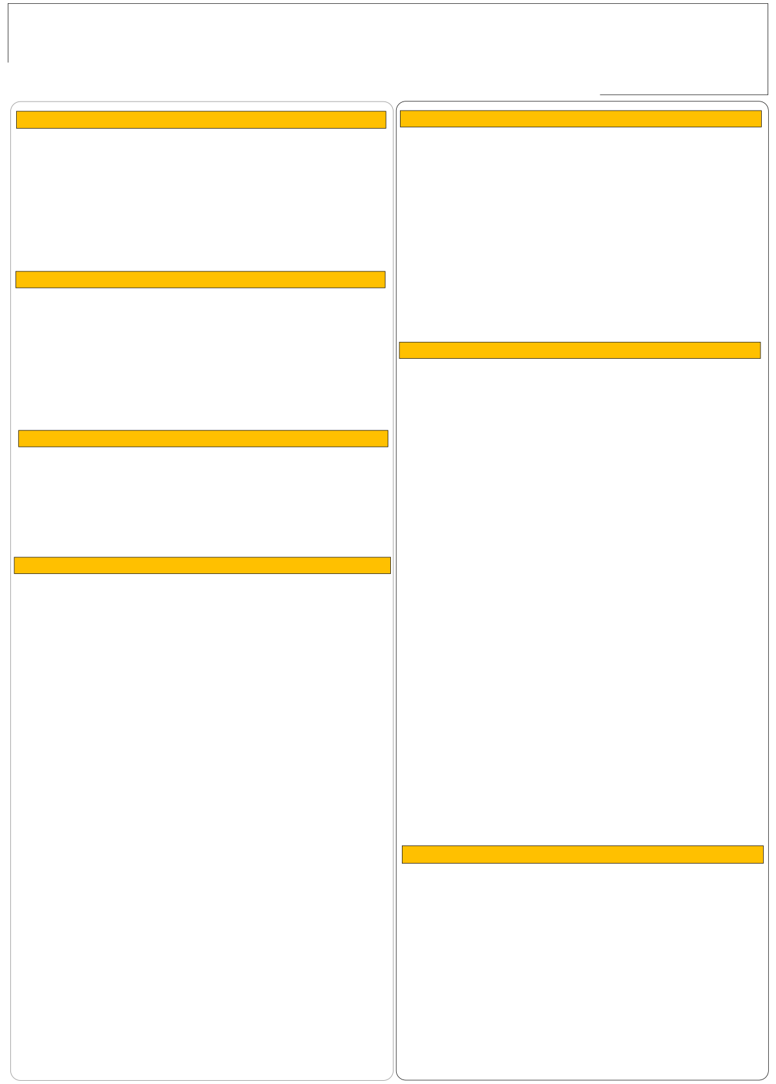

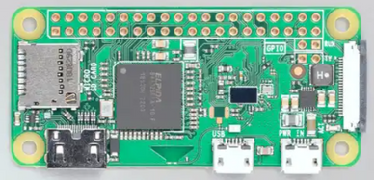
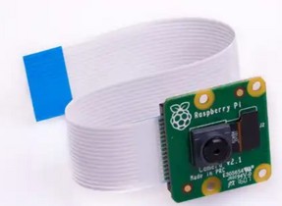

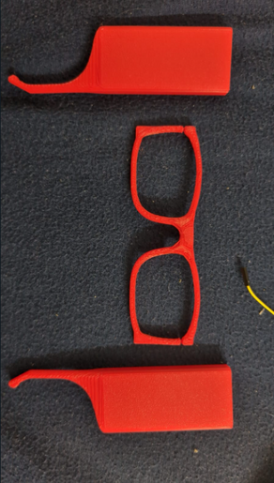
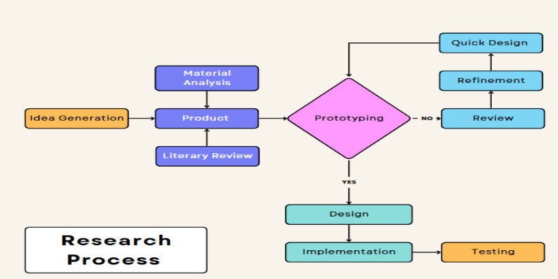
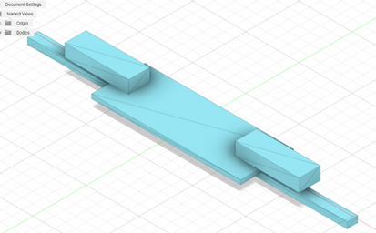
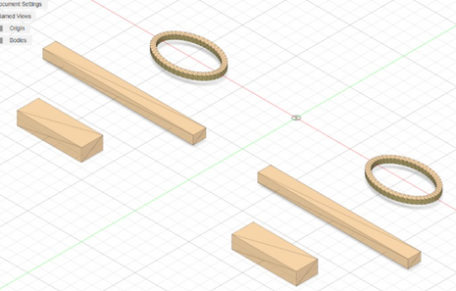

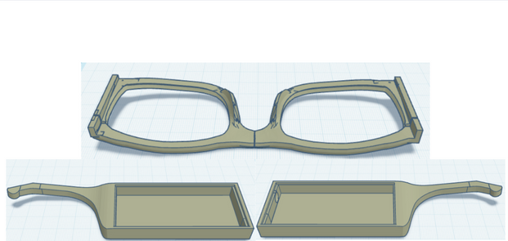
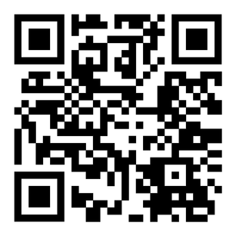
RV College of Engineering, Bengaluru – 560059. Title: Ikshana- Smart Glasses for the Visually Impaired and Blind
Go, change the world
Arya Wadhwa | Shivani Srinivasan | Bahuleya Mahesh | Devansh Mathur | RVCE24BC101 | RVCE24BBT012 | RVCE24BC016 | RVCE24BME013 |
Theme: Manufacturing Processes
Introduction
Tools and Parts Used
Blindness and visual impairment affect millions globally, with 253 million individuals impacted, including 4.95 million in India. Many lose their sight due to lack of early detection and intervention, facing not only vision loss but also societal discrimination and accessibility challenges.
In response, our mission is to create an innovative, cost-efficient solution that stands out from current products, addressing the unique needs of this demographic in India and beyond
Raspberry Pi Zero W
Raspberry Pi Camera Module
Problem Definition
Current assistive technology for visually impaired individuals is not completely accurate, has a limited field of view, limited range of object detection and the navigation system is not implemented properly.
Fusion 360: Software used for designing the frames
Results and Discussions
Thus the visually impaired individuals in India face significant
challenges that emphasize the need for improved assistive technology
Objectives
Creating a less bulky and more ergonomic design of a pair of glasses that emphasizes on ease of use for all customers and also focuses on being economical and environmental friendly.
3D Printed Frames Outcome
Utilizing algorithms for object detection and giving responses using text to speech, attempting to minimize feedback delays
The system demonstrates high accuracy in detecting objects across various environments, with consistent performance in most settings.
It helps reduce collisions, especially in well-lit areas, but proves more effective in low-light or crowded environments.
However, there is still room for improvement, particularly in enhancing its performance in challenging low-light conditions and densely packed spaces
Methodology
Resarch Process Flowchart
Conclusions
As we conclude this phase of our project, we’re proud of the progress made toward creating smart glasses for the visually impaired.
Through refined 3D modeling, integrated electronics, and advancements in object detection, we’ve taken steps towards creating a solution that is more efficient and reliable.
These innovations bring us closer to delivering a product that enhances independence and quality of life for the visually impaired.
References
Chang, K.-W., Zeng, Y., & Lin, T.-K. (2024). Echolocation glasses: Enabling the visually impaired to sense their environment. ICAEEE.
Zhang, L., Liu, Q., & Wang, Y. (2020). Assistive object recognition system for visually impaired. IEEE Transactions on Neural Systems and Rehabilitation Engineering, 28(3), 756-765.
Design Iteration 1
Design Iteration 2
QR Code of the Demonstration Video
Final Design

